Slide 2
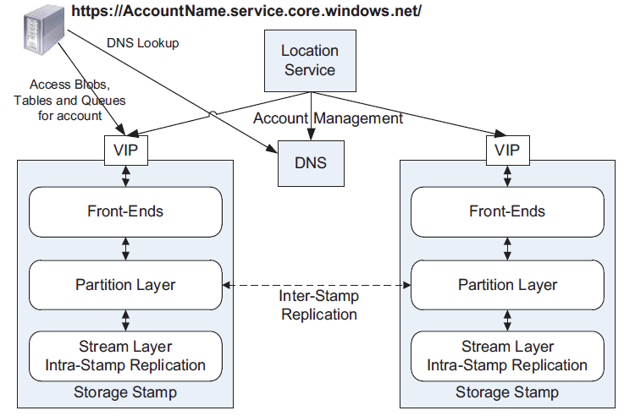
Windows Azure Storage Stamps

Slide 3
Partition Layer
The Partition layer provides:
Data models for types of objects (Blob, Table, Queue)
Logic to process these types of objects
Namespace for the objects
Load balancing
Transaction ordering and strong consistency

Slide 4
Partition Layer
Data model: Object Table (OT) – Account Table, Blob Table, Entity Table, Message Table
OTs are broken into RangePartitions and spread across Partition Servers
Partition Map Table keeps track of RangePartitions and Partition Servers
Load balancing: reassign, split, merge Range Partitions

Slide 5
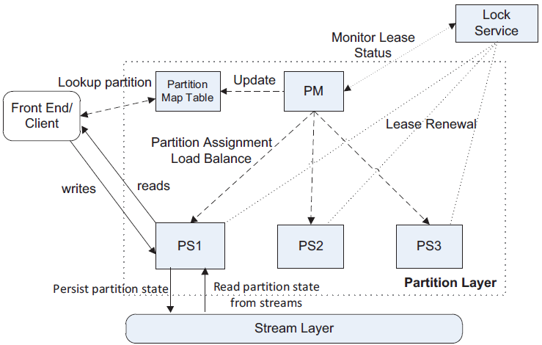
Partition Layer

